Slide 1
Climate change
APES
Moberg

Slide 2
Anthropogenic impact
weather fluctuates from day to day or even hourly. Climate is the long term average of weather patterns and is measured over decades.
For the past 1,000 years the average temperature of the Earth has bee stable, but began to rise during the 19th century when humans began to clear large areas of forest and burn more fossil fuels

Slide 3
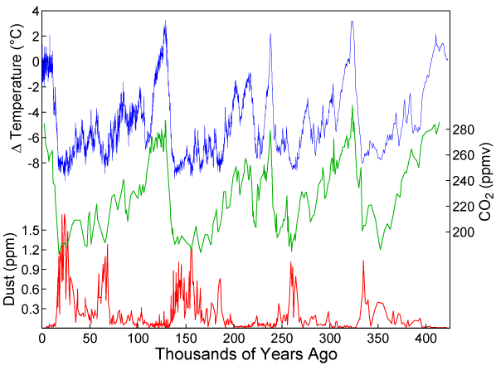
Past and present climate data
Ice core data (past)
present
Between 1906 and the present global temperatures have risen about 0.9 degrees Celsius.
https://climate.nasa.gov/

Slide 4
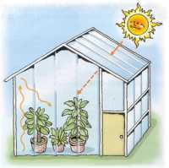
Earth warms through the Greenhouse Effect
Natural Greenhouse Effect – without it the planet would be a cold and mostly lifeless planet
Incoming wave = visible light wave (short wave) passes through the atmosphere to the surface
Outgoing wave = infrared wave (long wave, HEAT) releases most but not all of the gained energy from the surface

Slide 5
Climate Change
Water vapor (H₂O), carbon dioxide (CO₂), methane (CH₄) and nitrous oxide (N₂O) influence climate by trapping long wave infra-red radiation (heat) in the lower atmosphere and the earth’s surface, preventing it from escaping back to space
These gases are collectively termed GREENHOUSE GASES (GHG) because they warm the earth

Slide 6
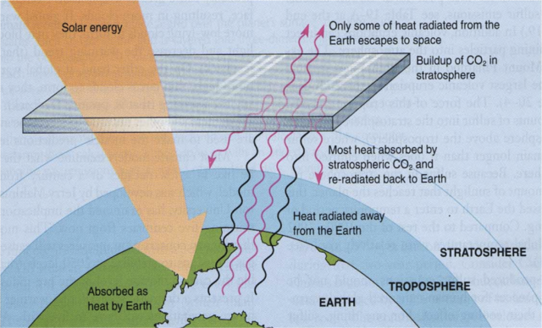
Greenhouse gas molecules
Ranking the gases by their contribution to the greenhouse effect:
  Water vapor 34-70%
  Carbon dioxide 9-26%
  Methane 4-9%
  Tropospheric ozone 3-7%
  Nitrous oxide and CFCs are also GHG (no data)
  Water vapor is in the atmosphere for only one week so does not contribute to long term climate change

Slide 7
GHG vibrate (resonate) with long wave radiation
GHG trap heat simply because they capture energy and vibrate, redirecting the energy back towards the surface of the earth.
https://scied.ucar.edu/greenhouse-effect-video-scott-denning

Slide 8
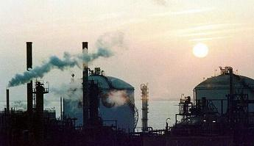
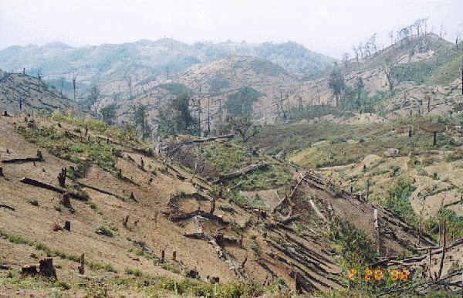
“Anthropogenic or Enhanced Greenhouse Effect”
There is a high probability (90-99%) that increasing concentrations of greenhouse gases in the troposphere are from burning fossil fuels, deforestation, agriculture and the manufacture of cement (IPCC)

Slide 9
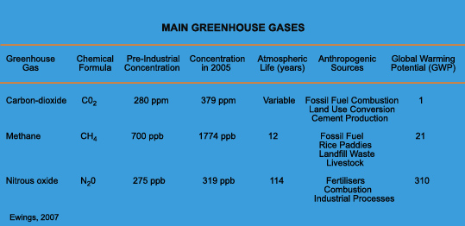
Each greenhouse gas has a specific global warming potential

Slide 10
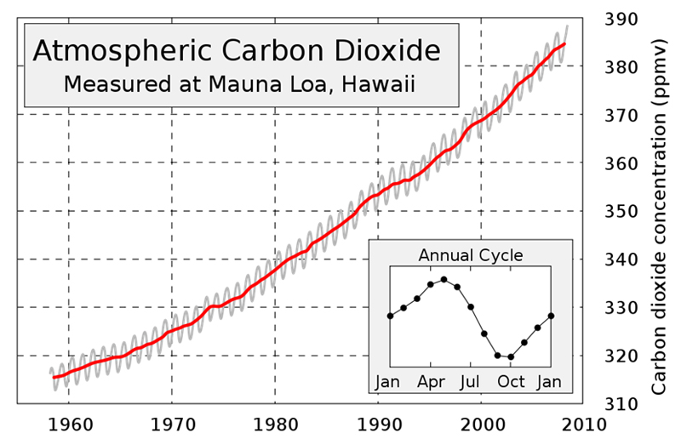
CO₂ levels in Atmosphere have risen sharply over the years.
The up and down nature of the curve represents periods of high photosynthesis (summer) and low photosynthesis (winter)

Slide 11
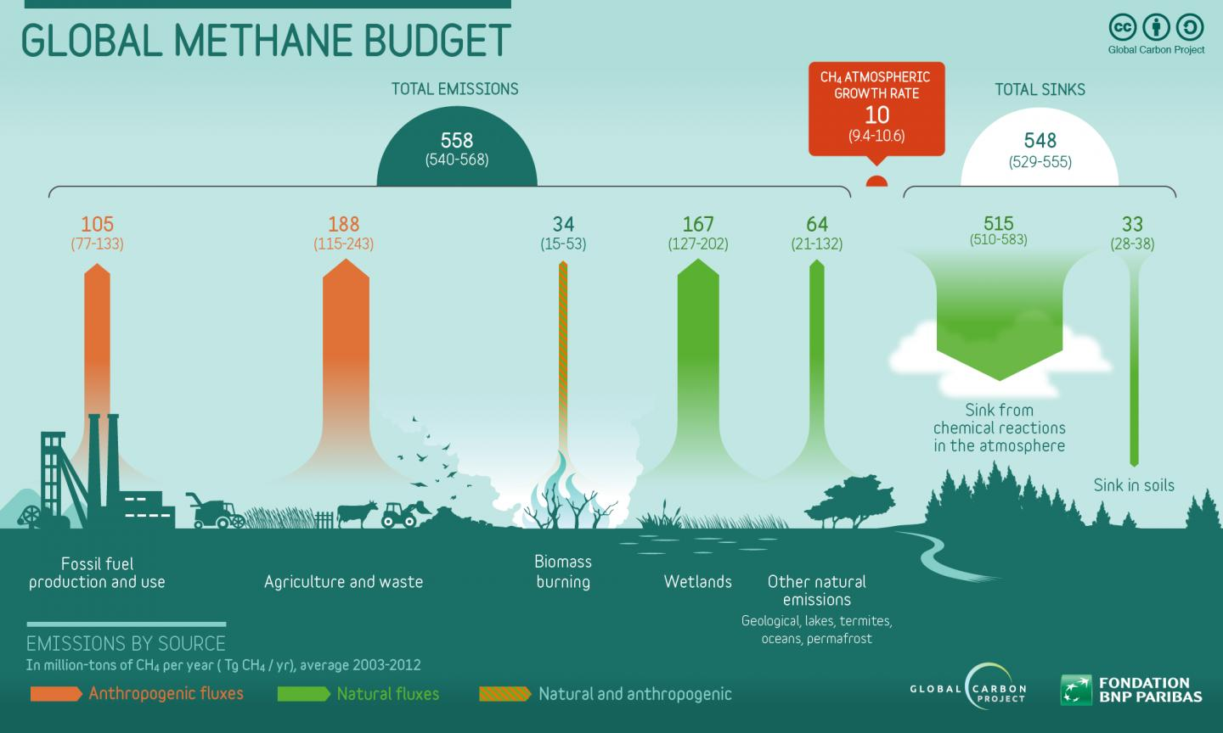
Methane, CH₄
Methane is produced through agriculture, especially in CAFOs and rice paddies or naturally from wetlands

Slide 12
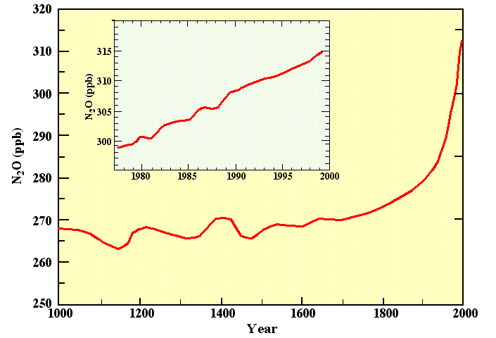
Nitrous Oxide Increases in Atmosphere
N₂O increases due to:
1. During combustion
Of fossil fuels (except for natural gas)
2. Denitrification
Of excess fertilizer in soil on farms

Slide 13
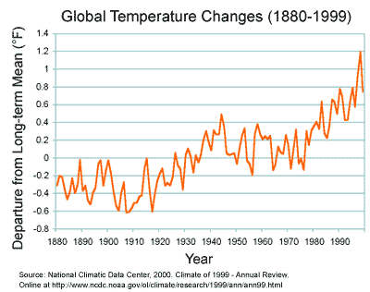
Temperature Changes
Past temperature changes are estimated by the analysis of radioisotopes in rocks and fossils, plankton and radioisotopes in ocean sediments, ice cores from ancient glaciers, tree rings, and historical records.
There has been an approximately 1°C rise in the past one hundred years

Slide 14
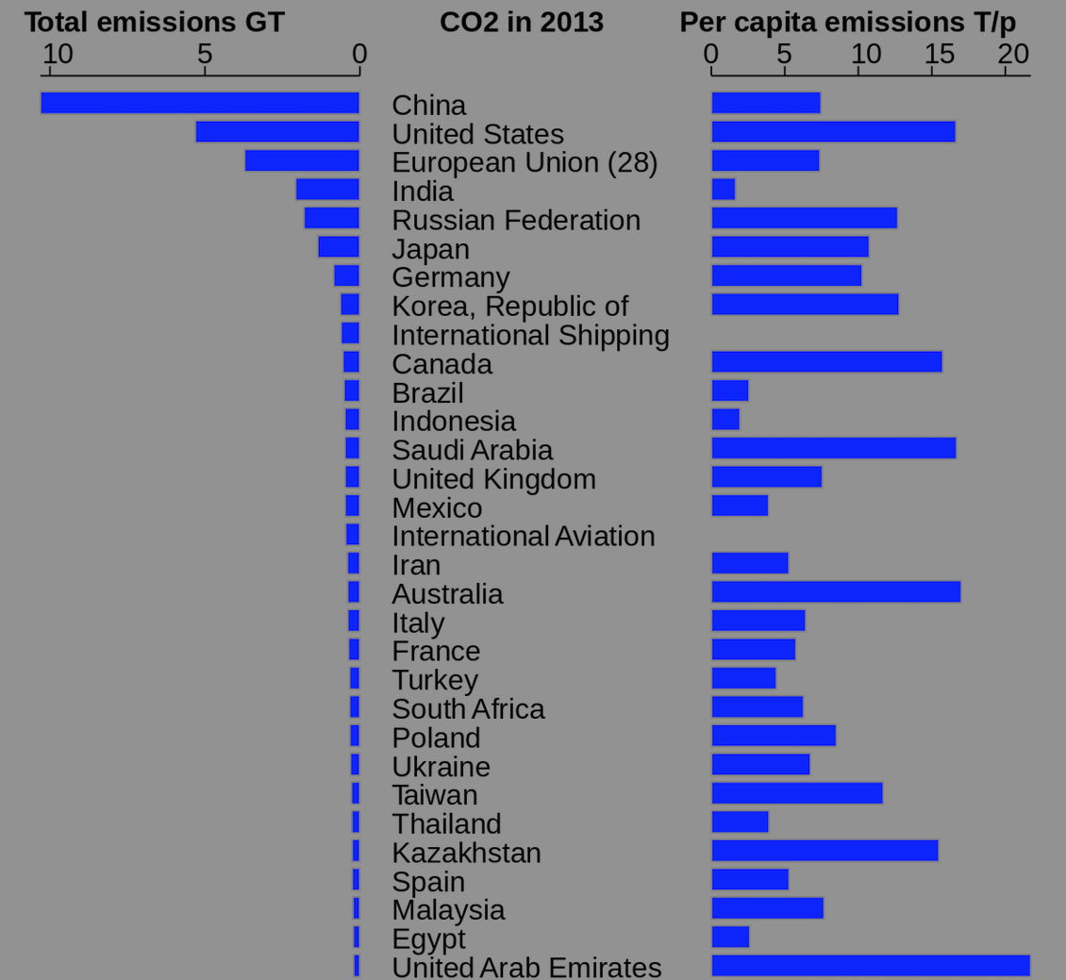
Major producers of carbon dioxide

Slide 15
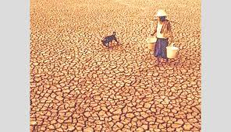
Predicted Effects of Global Warming
Agricultural changes : food-growing areas shifting pole-ward, lower grain yields, increased irrigation demands, increased pests, diseases and weeds in warmer latitudes.
Water Resources : drought, flooding, snowpack reduction, melting of glaciers stress community drinking water sources

Slide 16
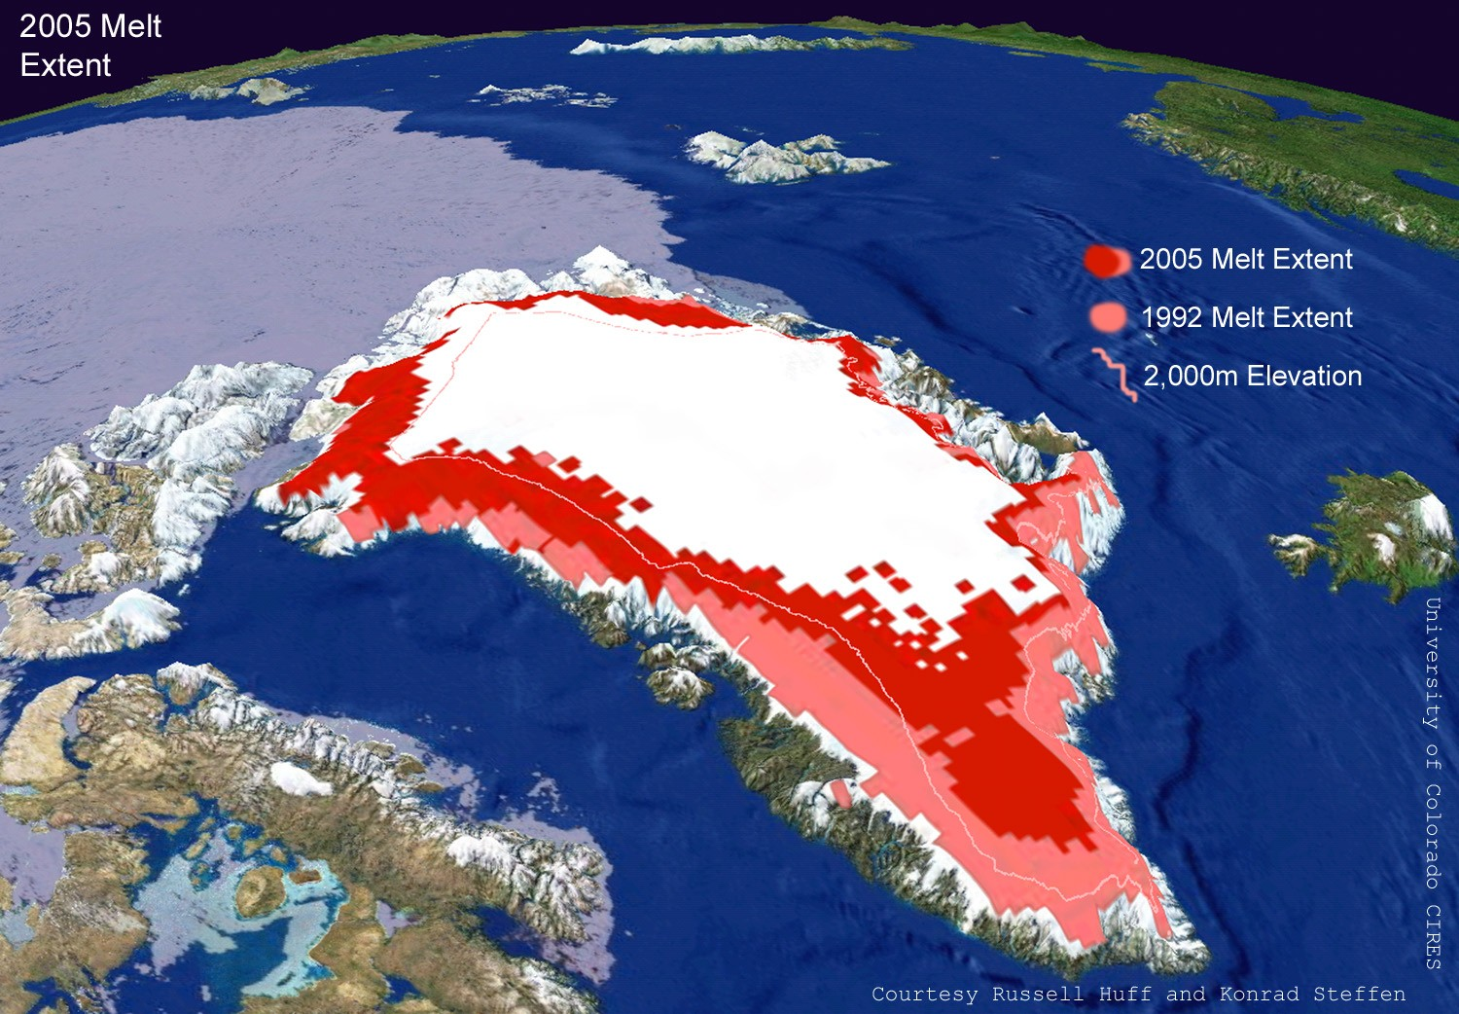
Melting ice in Greenland
Increasing loss of ice during summer months
Sea levels will rise
Glaciers in Greenland contain large amounts of fresh water, enough to raise sea levels several feet when melted.
As the atmosphere warms more and more snow is melted and the glaciers lose mass and retreat (see extent of red versus pink in the image)

Slide 17
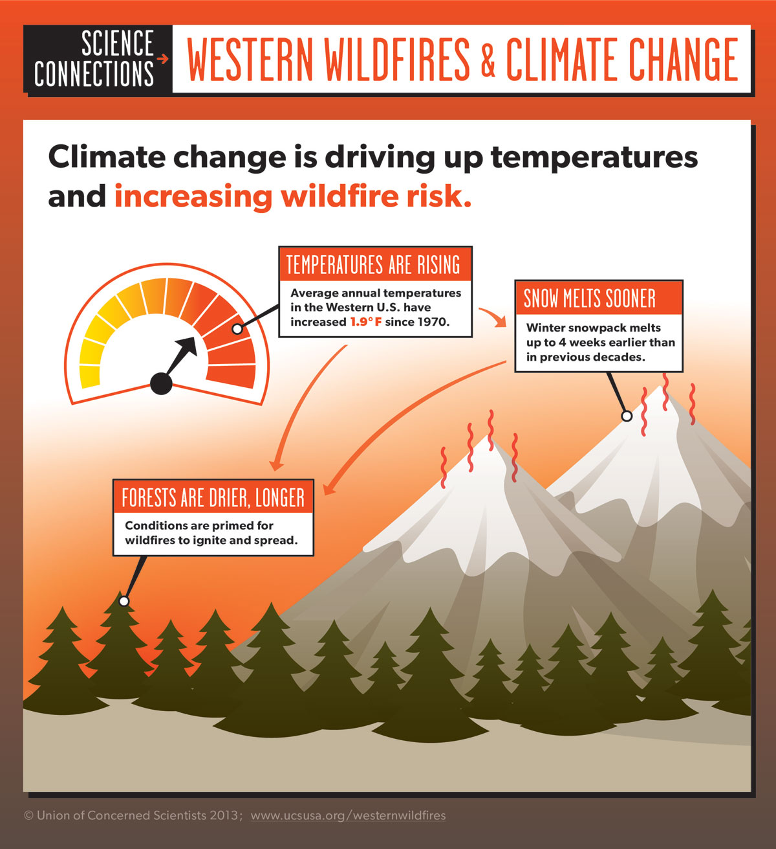
Predicted Effects of Global Warming
Forests : increased bark beetle infestation; disappearance of high altitude forests;
increased wildfires; loss of wildlife habitat and biodiversity.

Slide 18
Oceans Moderate Global Temperature
The oceans absorbs 29% of the excess CO₂ in the atmosphere as part of the anthropogenic carbon cycle. Oceans are a carbon sink. They become more acidic when they absorb CO₂
The oceans also absorb heat from the atmosphere and slowly transfer it to the deep ocean. Oceans are also a heat sink
Ocean currents act as giant convection convection currents transferring heat from the equator to the poles causing them to warm the fastest.

Slide 19
Other Synergistic Effects From climate change
Increased CO₂ in the troposphere could increase photosynthesis, but this would only be temporary. More carbon dioxide would warm the air, evaporating the water required for photosynthesis, so in the end less grain would grow.
Warmer air can release methane stored in permafrost, arctic bogs, wetlands, and make the air even warmer since methane is a GHG this is a positive feedback loop
Melting ice caps reduce the Earth’s albedo (reflectiveness), causing it to absorb more short wave radiation and get warmer to melt more ice. This is also a positive feedback loop.

Slide 20
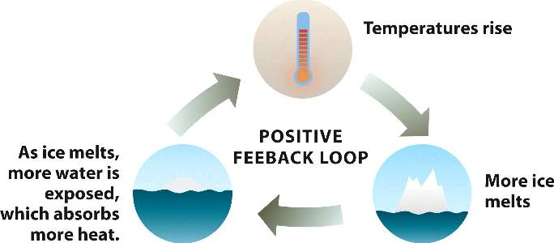
This positive feedback loop also explains why the poles are warming the fastest

Slide 21
The Paris Accord, 2015
195 Nations around the world have agreed to try to limit the temperature change to less than 2 degrees Celsius above pre-industrial levels
Strengthen societies’ ability to deal with impacts of climate change, including emergency preparedness and risk insurance
Scale up efforts to reduce emissions
The Kyoto Protocol, 1997
37 nations agreed to reduce GHG emissions
Invest in clean development projects
Places heavier burden on developed countries since they are principally responsible for the current levels due to 150 years of industrial activity
The USA never ratified this treaty

Slide 22
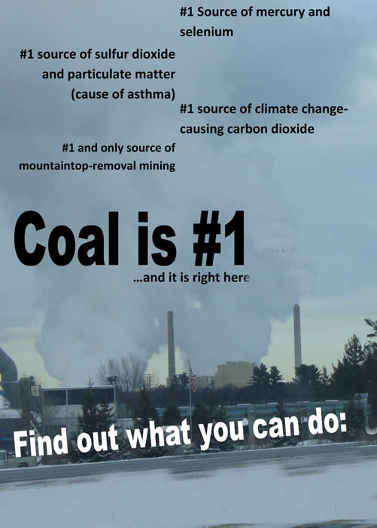
Personal choices that mitigate climate change by lowering GHG emissions
  Use low energy appliances, passive solar or install solar panels in your home
  Put lights on timers or motion sensors so they only come on when needed
  Dry clothes in the sunshine
  Eat more vegetarian meals to reduce meat production
  Use/ develop mass transit or walk/bike whenever possible

Slide 23
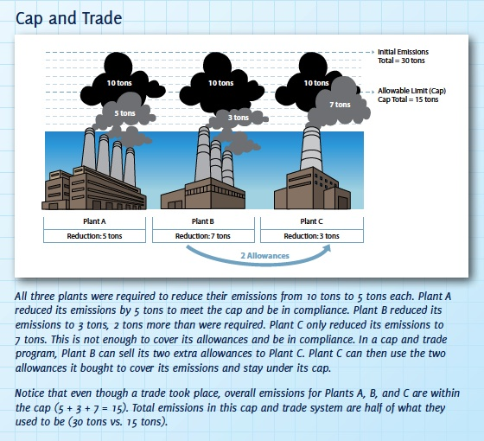
Cap and trade works to reduce overall emissions from burning fossil fuels

Slide 24
Technology that can capture and sequester carbon emissions (storage)
Carbon dioxide is released when coal burns and is trapped by a solvent before it leaves the smokestack.
A stripper separates CO₂ from the solvent and transports it for industrial use (carbonated beverages, chemical industry)
Additional CO₂ is injected deep underground into wells, seams and salt formations for long term storage

Slide 25
Climate adaptations help deal with consequences of climate change that cannot be avoided
For water issues
For air temp issues
Build flood barriers (levees, seawalls) to protect infrastructure
Relocating utility infrastructure to higher elevation to protect from coastal erosion or sea level rise
Increase groundwater storage areas and diversify drinking water sources
Install low dams across tidal estuaries to prevent salt water intrusion upriver
Install cool roofs (light colored), green roofs and urban forestry programs to protect the public from extreme heat
Developing drought tolerant crops

